Slide 1

DATA SCIENCE
10 WEEK PART TIME COURSE

Slide 2
AGENDA
Motivation / Review
Unsupervised learning - What is Clustering?
What is K-Means and how does it work?
What is DBSCAN and how does it work?
What is hierarchical clustering and how does it work?
How do we measure the performance of clustering?
Lab
Supervised learning: cluster-based classifiers and regressors
Discussion - Homework

Slide 3
WHAT IS CLUSTERING AND WHY DO IT?
DATA SCIENCE PART TIME COURSE

Slide 4
CLUSTERING
What is a Cluster?
Why would we do this?
What is K-Means?
x₁
x₂

Slide 5
WHAT IS A CLUSTER?
Unsupervised learning is when we are trying to find interesting patterns or groups in our data.
We don’t have a variable we are trying to predict (a Y value).
Clustering aims to discover subgroups in our data where the points are similar to each other.
We have to decide what variables we will construct the groups on.
What makes them different (or similar)?

Slide 6
WHY WOULD WE CLUSTER DATA?
To give us a hint about what might be worth visualizing
To enhance our understanding of a dataset by dividing the data into groups.
Clustering provides a layer of abstraction from individual data points.
The goal is to extract and enhance the natural structure of the data

Slide 7
WHY WOULD WE CLUSTER DATA?
Marketing teams might want to group customers into like groups as a way of summarising the data

Slide 8

WHY WOULD WE CLUSTER DATA?
Financial groups may want to group transactions into like groups as a way to find unusual payments

Slide 9
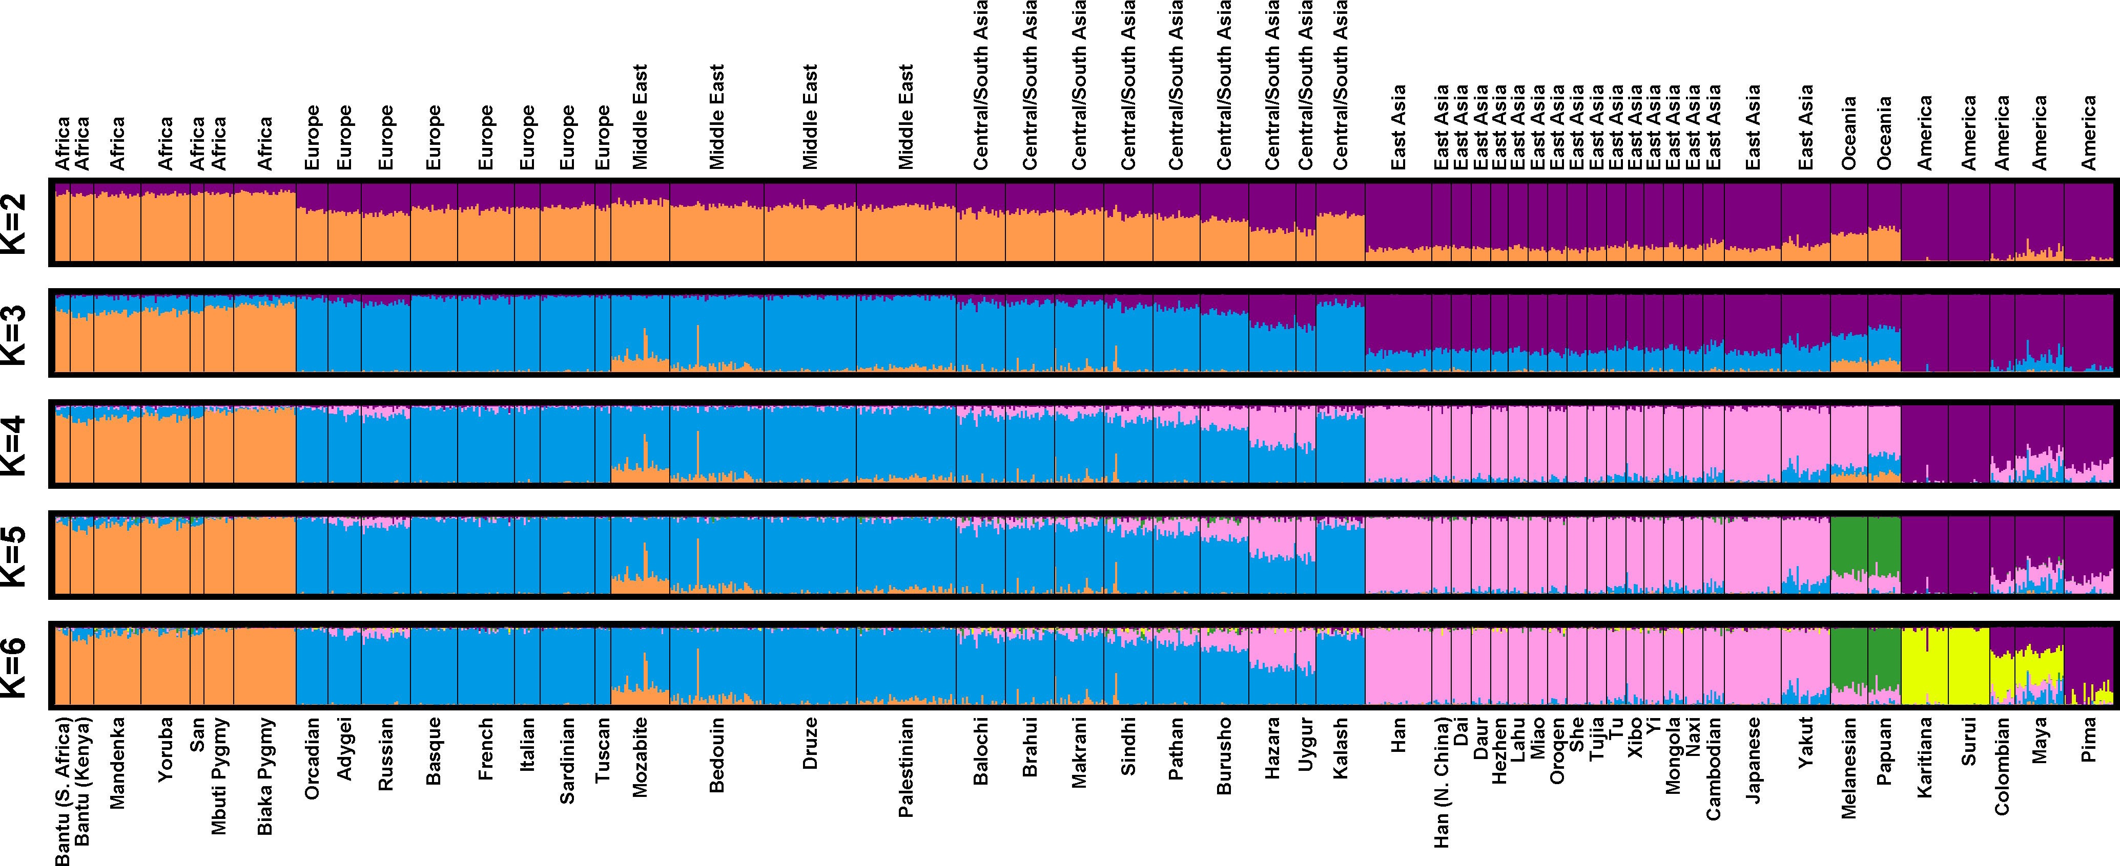
WHY WOULD WE CLUSTER DATA?
Genetics data can be clustered to identify ancestry

Slide 10
HOW DO WE CLUSTER DATA?
DATA SCIENCE PART TIME COURSE

Slide 11
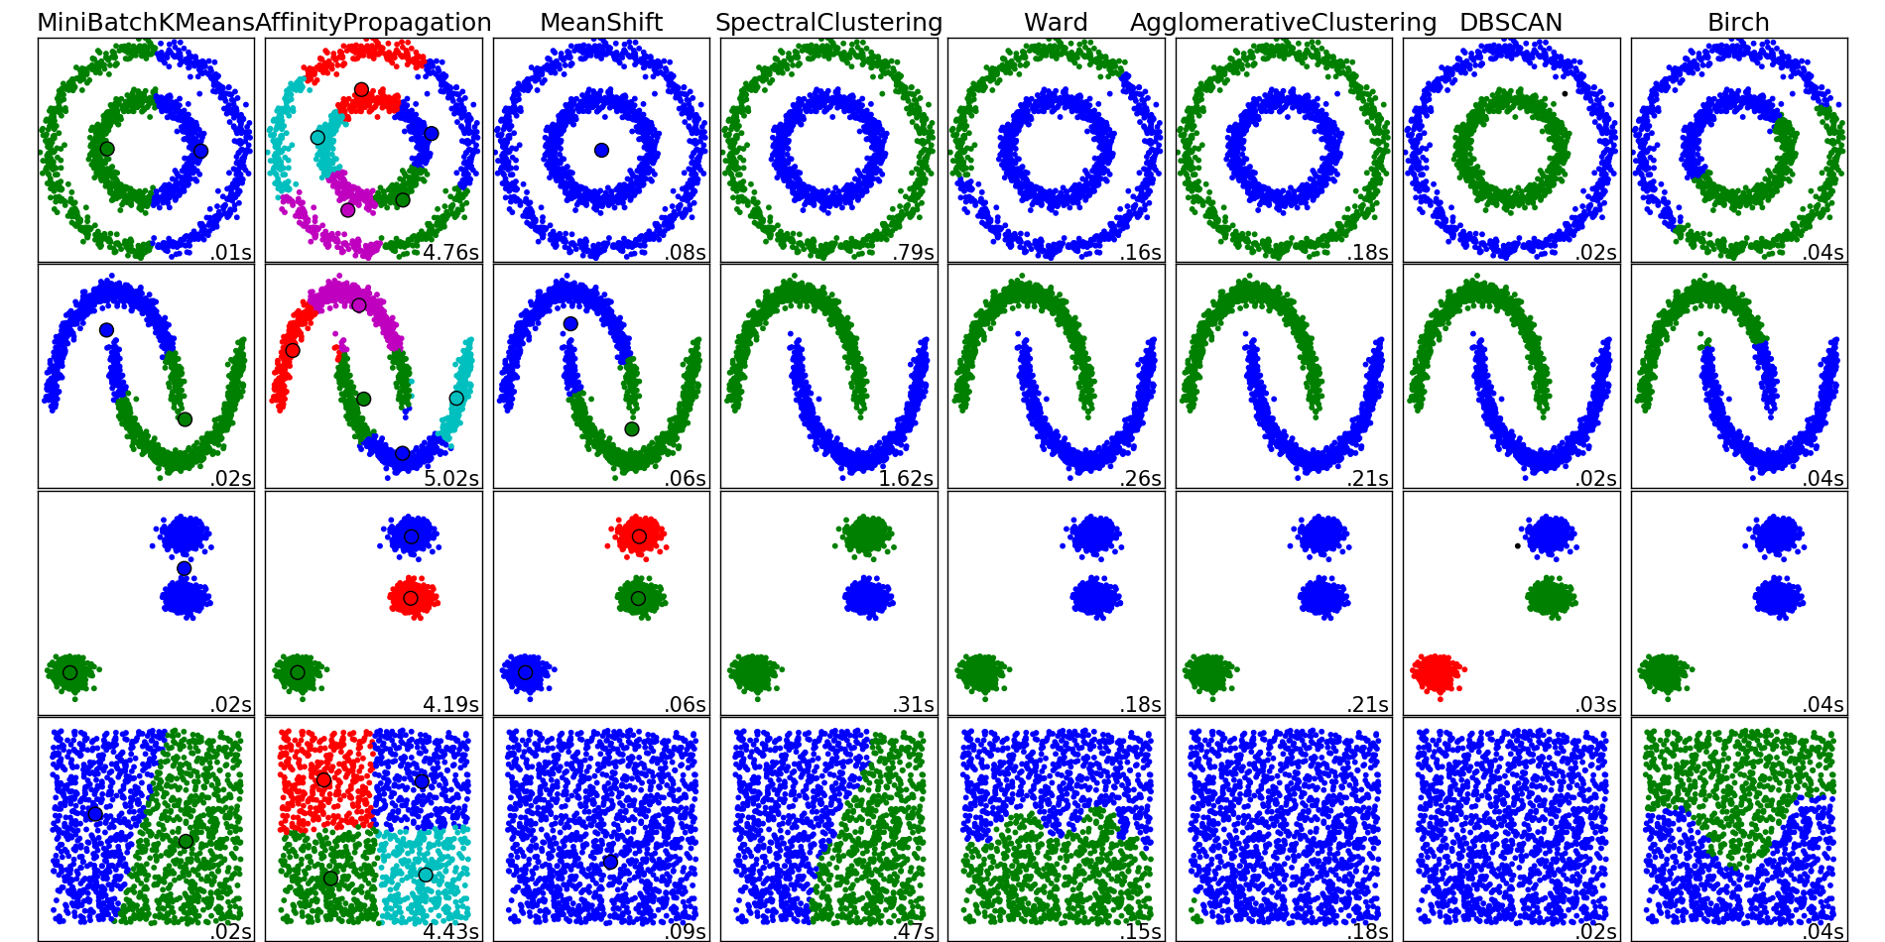
Scikit-learn has many clustering algorithms…

Slide 12
K-means
DATA SCIENCE PART TIME COURSE

Slide 13
KMEANS ALGORITHM
1) Choose k initial centroids (note that k is an input)
2) For each point:
- find distance to each centroid
- assign point to nearest centroid
3) Recalculate centroid positions
4) Repeat steps 2-3 until stopping criteria met

Slide 14
STEP 1 - CHOOSE CENTROIDS
There are several options:
- randomly (but may yield divergent behavior)
- perform alternative clustering task, use resulting centroids as initial k-means centroids
- start with global centroid, choose point at max distance, repeat (but might select outlier)

Slide 15
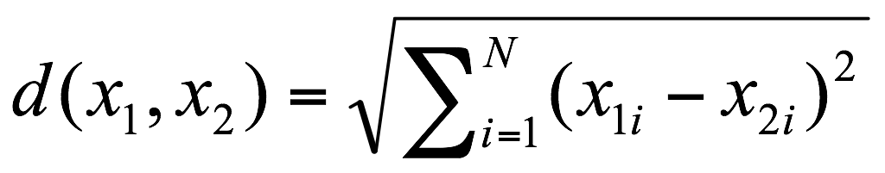
STEP 2 - ASSESS SIMILARITY
The similarity criterion is determined by the measure we choose.
In the case of k-means clustering, the similarity metric is often the Euclidian distance:
Which means that you probably don’t want different ranges across different parameters (e.g. 0-1 on one parameter 0-1million on another).

Slide 16
STEP 3 - RECALCULATE CENTROID POSITIONS
Q: How do we re-compute the positions of the centres at each iteration of the algorithm?
A: By calculating the centroid (i.e., the geometric centre)

Slide 17
STEP 4 - CONVERGENCE
We iterate until some stopping criteria are met; in general, suitable convergence is achieved in a small number of steps.
Stopping criteria can be based on the centroids (eg, if positions change by no more than ε) or on the points (eg, if no more than x% change clusters between iterations).

Slide 18
KMEANS ALGORITHM
1) Choose k initial centroids
2) For each point:
- find distance to each centroid
- assign point to nearest centroid
3) Recalculate centroid positions
4) Repeat steps 2-3 until stopping criteria met
x₁
x₂

Slide 19
KMEANS ALGORITHM
1) Choose k initial centroids
2) For each point:
- find distance to each centroid
- assign point to nearest centroid
3) Recalculate centroid positions
4) Repeat steps 2-3 until stopping criteria met
x₁
x₂

Slide 20
KMEANS ALGORITHM
1) Choose k initial centroids
2) For each point:
- find distance to each centroid
- assign point to nearest centroid
3) Recalculate centroid positions
4) Repeat steps 2-3 until stopping criteria met
x₁
x₂

Slide 21
KMEANS ALGORITHM
1) Choose k initial centroids
2) For each point:
- find distance to each centroid
- assign point to nearest centroid
3) Recalculate centroid positions
4) Repeat steps 2-3 until stopping criteria met
x₁
x₂

Slide 22
KMEANS ALGORITHM
1) Choose k initial centroids
2) For each point:
- find distance to each centroid
- assign point to nearest centroid
3) Recalculate centroid positions
4) Repeat steps 2-3 until stopping criteria met
x₁
x₂

Slide 23
KMEANS ALGORITHM
1) Choose k initial centroids
2) For each point:
- find distance to each centroid
- assign point to nearest centroid
3) Recalculate centroid positions
4) Repeat steps 2-3 until stopping criteria met
x₁
x₂

Slide 24
KMEANS ALGORITHM
1) Choose k initial centroids
2) For each point:
- find distance to each centroid
- assign point to nearest centroid
3) Recalculate centroid positions
4) Repeat steps 2-3 until stopping criteria met
x₁
x₂

Slide 25
KMEANS ALGORITHM
1) Choose k initial centroids
2) For each point:
- find distance to each centroid
- assign point to nearest centroid
3) Recalculate centroid positions
4) Repeat steps 2-3 until stopping criteria met
x₁
x₂

Slide 26
KMEANS ALGORITHM
1) Choose k initial centroids
2) For each point:
- find distance to each centroid
- assign point to nearest centroid
3) Recalculate centroid positions
4) Repeat steps 2-3 until stopping criteria met
x₁
x₂

Slide 27
CLUSTER VALIDATION
Strengths:
K-means is a popular algorithm because of its computational efficiency and simple and intuitive nature.
Weaknesses:
However, K-means is highly scale dependent, and is not suitable for data with widely varying shapes and densities.

Slide 28
HOW DO WE KNOW OUR k-MEANS CLUSTERS ARE ANY GOOD?
DATA SCIENCE PART TIME COURSE

Slide 29
CLUSTER VALIDATION
In general, k-means will converge to a solution and return a partition of k clusters, even if no natural clusters exist in the data.

Slide 30
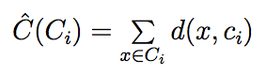
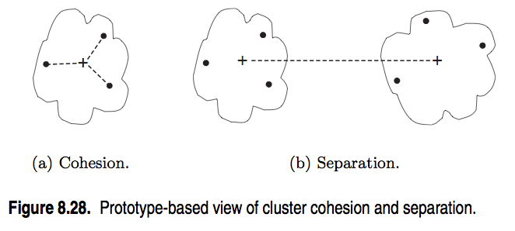
CLUSTER VALIDATION – COHESION
Cohesion measures clustering effectiveness within a cluster.
How far are the points in the cluster away from
the centroid?
Add up those distances.
We’d like to see a small number.

Slide 31
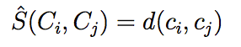
CLUSTER VALIDATION - SEPARATION
Separation measures clustering effectiveness between clusters.
i.e. How far apart are the centroids?

Slide 32
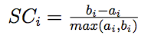
CLUSTER VALIDATION – SILHOUETTE COEFFICIENT
One useful measure than combines the ideas of cohesion and separation is the silhouette coefficient. For point i, this is given by:
such that:
ai = average distance from i to the other members of its clump
bi = average distance from i to the members of the next best clump

Slide 33
CLUSTER VALIDATION – SILHOUETTE COEFFICIENT
If it’s closer to members of another cluster than it is to it’s own cluster, this numerator goes negative (bad)
If it’s a long way from another cluster, then b will be much bigger than a, so this will get close to +1
(good)
But if it’s a long way away from anything, it was probably a lost cause anyway. A big denominator will make it close to zero.

Slide 34
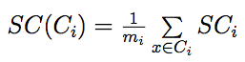
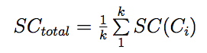
CLUSTER VALIDATION
The silhouette coefficient for the cluster Ci is given by the average silhouette coefficient across all points in Ci:
The overall silhouette coefficient is given by the average silhouette coefficient across all clusters:

Slide 35
CLUSTER VALIDATION
One useful application of cluster validation is to determine the best number of clusters for your dataset.
Q: How would you do this?
A: By computing the Silhouette Coefficient for different values of k.

Slide 36
Silhouette (Scoring API)
import sklearn.metrics
S=sklearn.metrics.silhouette_score(Interesting_Scores,
Clusters)

Slide 37
CLUSTER VALIDATION
Other useful measures:
Calinski-Harabasz
Davies-Bouldin

Slide 38
DBSCAN & OPTICS
DATA SCIENCE PART TIME COURSE

Slide 39
DBSCAN
Choose a minimum neighbor count and a radius.
Choose a point: does it have enough neighbours in range?
Repeat
No
Put it aside until later
Yes
Are any of them in a cluster?
No
Yes
Make a new cluster
Put this point in that cluster.
(Merge clusters if there are several)

Slide 40
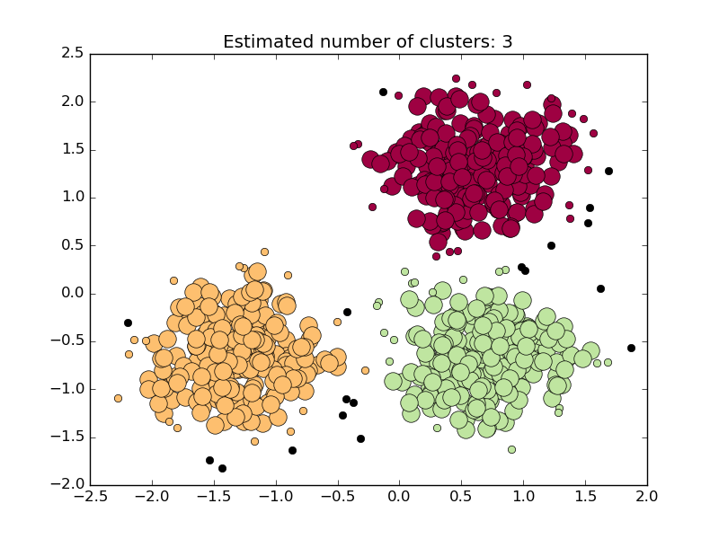

Slide 41
Limitations
﻿DBSCAN cannot cluster data sets well with differences in densities
What neighbor count and radius would you choose?
Double the data = 4 times the memory requirements

Slide 42
Optics
﻿OPTICS can cluster data sets well with differences in densities, as it adapts eps
Usually slower than DBSCAN

Slide 43
Interactive Immersive Experience Cards, Sticky labels, Measuring tape
DATA SCIENCE PART TIME COURSE

Slide 44
KMeans sklearn API
import sklearn.cluster
Clusterer = sklearn.cluster.KMeans(init=‘kmeans++’,
n_clusters=3)
DF = pandas.DataFrame(…)
Interesting_Columns = DF[[‘Column1’,’Column2’]]
Clusters = Clusterer.fit_predict(Interesting_Columns)
DF[‘Cluster’] = Clusters

Slide 45
Displaying a 2D clustering
Colouring = numpy.array([‘red’,’green’,’blue’])
matplotlib.pyplot.scatter(DF.Column1, DF.Column2,
color=Colouring[Clusters])
Matplotlib.pyplot.scatter(Clusterer.cluster_centers_[:,0],
Clusterer.cluster_centers_[:,1],
marker=“+”, s=30)

Slide 46
DBSCAN sklearn API
﻿import sklearn.cluster
Clusterer = sklearn.cluster.KMeans(eps=200,
min_samples=3)
DF = pandas.DataFrame(…)
Interesting_Columns = DF[[‘Column1’,’Column2’]]
Clusters = Clusterer.fit_predict(Interesting_Columns)
DF[‘Cluster’] = Clusters

